Slide 1
Artificial Intelligence
LECTURE: 4

Slide 2
Problem Solving in AI World
Problem-solving in AI refers to the process where an intelligent system identifies a solution by searching through a space of possible states.
It involves defining the problem, exploring possible solutions, and applying an optimal method to reach the goal.

Slide 3
Goal-Based Problems / Problem-Solving Agents
A problem-solving agent operates by considering the goal it needs to achieve and taking actions accordingly.
Unlike reflex agents (which react based on conditions), problem-solving agents think ahead and determine a sequence of actions to achieve the desired outcome.

Slide 4
Problem-Solving Process
A problem-solving agent follows a systematic approach, which includes:
Formulating the Problem
  Define the initial state, goal state, and possible actions.
Generating Possible Solutions (Search)
  Explore different actions and sequences of actions to reach the goal.
Evaluating the Solutions
  Assess the effectiveness and efficiency of solutions.
Executing the Best Solution
  Apply the most optimal solution in the given environment.

Slide 5
Problem Formulation
Problem formulation is the first and most crucial step in designing a problem-solving agent. It involves defining the problem in a structured way that allows the agent to search for a solution efficiently.
A well-defined problem consists of:
State Space: All possible that an agent can be in while solving a problem.
Initial State: The starting point of the agent.
Actions: A set of legal operations the agent can perform.
Transition Model: A description of how actions affect the state.
Goal Test: A function that checks if the goal state is achieved.
Path Cost: A measure of efficiency in reaching the goal.

Slide 6
Example: Vacuum World Problem
The Vacuum World Problem is a classic AI problem that involves an intelligent agent (a vacuum cleaner) operating in a simple environment with two rooms. The agent's goal is to clean both rooms efficiently by sensing the environment and performing appropriate actions.
Given:
A vacuum cleaner that can be in one of two locations: Left Room (L) or Right Room (R).
Each room can be either dirty or clean at any time.
The vacuum cleaner has three possible actions:
  clean Dirt (cleans the current room if dirty).
  Move Left (moves to the left room).
  Move Right (moves to the right room).
Problem Statement:
Design a problem-solving agent that takes the optimal sequence of actions to ensure both rooms are clean, minimizing the number of moves and cleaning operations required.

Slide 7
Step 1: State Space
The vacuum cleaner is in a world with two rooms: Left and Right.
Each room can be either clean or dirty.
The vacuum can perform three actions:
Move Left
Move Right
Clean Dirt (to clean the current room)
State Representation:
Each state can be represented as:
(Vacuum Position,Left Room Status,Right Room Status)

Slide 8
State Space
Possible States in the State Space:
Since each room can be dirty or clean, and the vacuum can be in two positions, we have:
2 (positions)×2 (left room states)×2 (right room states)=8 total states
State | Vacuum Position | Left Room | Right Room
S1 | Left | Dirty | Dirty
S2 | Left | Clean | Dirty
S3 | Left | Dirty | Clean
S4 | Left | Clean | Clean
S5 | Right | Dirty | Dirty
S6 | Right | Clean | Dirty
S7 | Right | Dirty | Clean
S8 | Right | Clean | Clean

Slide 9
Vacuum cleaner world problem
Step 2: Initial State: In this case any state can be designated as initial state
Step 3: Action State: Each state has three action (Left, Right, clean Dirt)
Step 4: Transition Model: We will apply all possible action to a given state and see how it goes from one state to another state (see next slide)

Slide 10
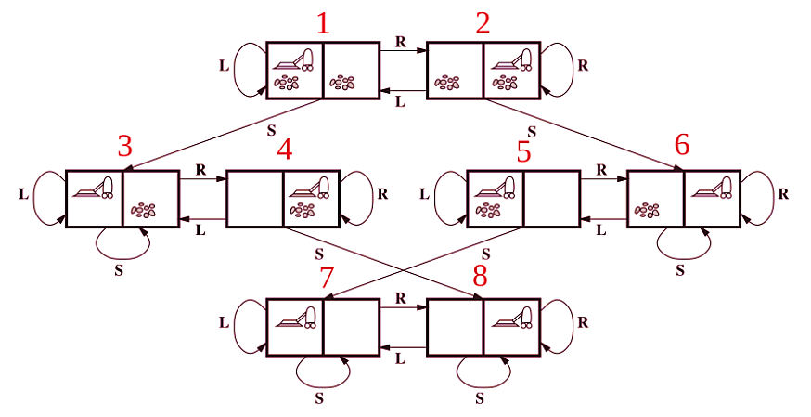
Transition Model:

Slide 11
Vacuum world problem
Step 5: Goal Test: The Problem is solved when both rooms are cleaned
Step 6: Path Cost: The optimal solution is the one that cleans both rooms with the fewest actions.
(Performance Measure)
The efficiency of the solution is measured by:
Number of steps taken (fewer is better).
Total cleaning actions performed.
Minimizing unnecessary movements.

